Slide 1
Full Stack Application Development
Securing API
OAuth and OpenID
OpenID
Akshaya Ganesan

Slide 2
OpenID

Slide 3
pseudo-authentication using OAuth
OAuth is an authorization protocol, rather than an authentication protocol.
OAuth does not provide user’s information via an access token
Access tokens are meant to be opaque.
They’re meant for the API, they’re not designed to contain user information.
Custom Hacks were used to fill this gap
Using OAuth on its own as an authentication method may be referred to as pseudo-authentication

Slide 4
OpenID Connect
OAuth is directly related to OpenID Connect (OIDC).
OIDC is an authentication layer built on top of OAuth 2.0.
OpenID Connect (OIDC) extends OAuth 2.0 with a new signed id_token for the client and a UserInfo endpoint to fetch user attributes
OpenID Connect is the standard for identity provision on the Internet.

Slide 5
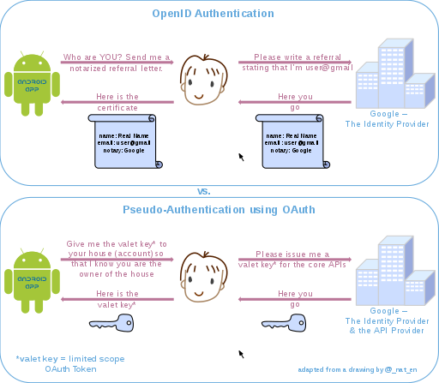
OpenID vs OAuth
Image Reference: https://commons.wikimedia.org/wiki/File:OpenIDvs.Pseudo-AuthenticationusingOAuth.svg

Slide 6
OpenID Connect
What it adds:
ID token
User endpoint to get more userinfo
Standardized
Its formula for success: simple JSON-based identity tokens (JWT), delivered via OAuth 2.0 flows that fit web, browser-based and native / mobile applications.

Slide 7
OAuth

Slide 8
Thank You!

